Slide 1
GraSPI
Graph-based Structure-Property Interrogator
Last updated on June 2020

Slide 2
Motivation: molecular vocabulary
large pool of descriptors/features exists
Dragon molecular descriptor list: 51 pages with 4885 descriptors
Do we need so many?
Data automation lowers energy barriers
Can we find the smallest set of features
Feature engineering and data analytics enables the reduction
Notes:
Dragon is used to
evaluate molecular structure-property relationships,
similarity analysis
high-throughput screening of molecule databases.

Slide 3
Descriptors, features, salient/hidden variables
In machine learning, a feature is an individual measurable property or characteristic of a phenomenon being observed. Features are usually numeric (but also strings and graphs).
Data win over model sophistication:
The More Features, The Merrier
Feature Man-Months Aren’t Mythical
Watson (DeepQA, Jeopardy): 20 engineers and researchers +
3 years of work.
Features may seem quite ordinary ingredients of the pipeline, but writing features can be extremely painful.
Notes:
Choosing informative, discrim
Features may seem quite ordinary ingredients of the pipeline (apart from raw data, cluster software, human-provided labels, scalable statistical algorithms). Writing features can be extremely painful.
Features, sometimes called signals, encode information from raw data that allows machine-learning algorithms to classify an unknown object or estimate an unknown value.
inating and independent features is a crucial step for effective algorithms pattern recognition, classification and regression.
Statistical break-throughs are academically “sexy,” but most trained systems seem to win through lots of features
feature scan be integrated through light-weight, loosely coupled statistical methods. Large numbers of feature engineers should be able to operate with minimal coordination, apart from the moment when their features’ statistical contributions are actually evaluated.

Slide 4
We propose a two-level representation
Level 1: voxel-based representation
Level 2: topology preserving representation
Microstructure
Graph
Microstructure
Distance map
Medial axis
Graph
Steps involved:
For each voxel in the microstructure image create vertex in graph
Connect vertices in the graph following neighborhood of the image (first and second order neighbors)
Steps involved:
calculate distance field to the interface
Remove voxel based on the distance field to get medial axis
Covert the medial axis into graph representation
GraSPI: Graph-based Structure descriptor Interrogator

Slide 5
What is GraSPI?
GraSPI annotates microstructure with the set of descriptors/features.
Given a segmented micrograph (black and white image), the set of descriptors is calculated.
The set of descriptors captures size, shape and topological characteristics of the morphology.
The set of descriptors has been motivated by the application for organic solar cells but can be generalized for other applications
To enable the generalization, we plan to group the descriptors into mathematical descriptors and physics-encoded descriptors.

Slide 6
What problem GraSPI solves?
As of now, given the segmented image, compute set of descriptors (scalars, histograms) and physics-weighted descriptors (scalars and histograms)
In the future, expand the set of descriptors to include more descriptors, expand the representation to include the skeletons (topological features), expand the physics-based weighting functions, add representation-specific distance measures (beyond the Euclidean distance) and couple it with dimensionality reduction techniques.

Slide 7
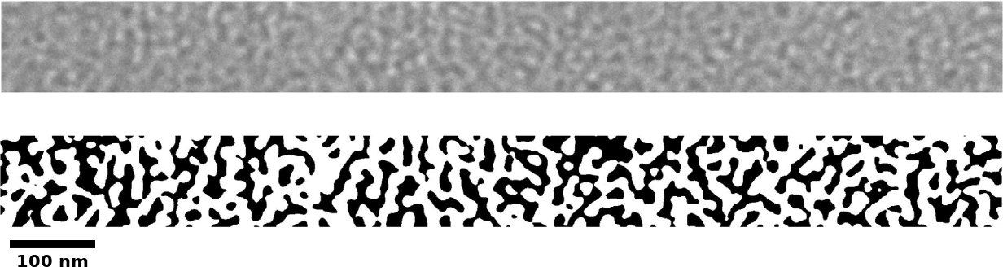
From micrograph to set of statistics and descriptors
Micrograph
Set of descriptors
/features

Slide 8
Graph-based representation is flexible to define and compute wide range of descriptors
Filter graph
Query filtered graph
Using standard graph-based algorithms
connected component algorithm
Shortest path
Microstructure
Graph={V,E}
Steps involved:
For each voxel in the microstructure image create vertex in graph
Connect vertices in the graph following neighborhood of the image (first and second order neighbors)
Filter graph and query the graph

Slide 9
Graph-based representation is flexible to define and compute math- and physics-based descriptors
Compute all distances
from black pixels to the interface (green meta vertex)
Compute histograms
Add the weighting function
that capture some aspect of the physics
Represent microstructure as a graph and add meta vertices
Filter graph
Make graph query:
Find shortest paths from
green vertex to all black vertices
Simple post processing Make queries to extract more specific descriptors
This physics—based descriptor is meaningful and serves as a surrogate for PDE-based model.
It captures non-local effects.

Slide 10
How it works
Represent morphology as graph
Add meta vertices to facilitate the computations of the descriptor (top/bottom surface, interface)
Learn how to filter the graph to facilitate graph queries for various features
Execute basic algorithms: e.g., compute connected components, compute the shortest paths

Slide 11
Descriptor=graph filtering (meta vertices)+graph algorithms
Filter graph

Slide 12
Computational complexity
GraSPI computes the set of descriptors at the low cost:
2D examples – order of seconds
3D examples – order of minutes
Note linear complexity of the execution
The largest problem solved on the desktop machine (35M) under 3 minutes
N- number of vertices
E- number of edges
Technical details: Coded in C/C++ using boost graph library

Slide 13
Important features
Works for structured (micrograph, tomography data) and unstructured data (molecular dynamics, atom probe data)
Graphs can be encoded to include information from other levels (e.g., DFT calculations)

Slide 14
Resources
https://arxiv.org/abs/1106.3536v2

